Slide 1
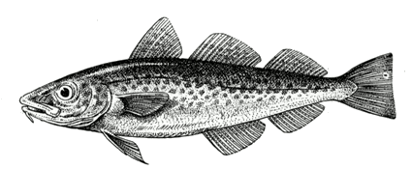



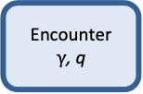
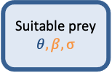
Calculated from von Bertalanffy k
Life-history data (fishbase)
Life-history data or assumed as 0.25*Winf
Regional stomach observations or
Spatio-temperoral overlap
Growth
$$W_{∞}$$
Suitable prey
$$θ, β, σ$$
Encounter
$γ$, q
Assimilation
α, h
Maturation
w_{mat}
Respiration
f_{c}
Reproduction
$$ε_{repro}$$
General (species-specific) stomach observation or literature
Provided by mizer,
usually not touched
Recruitment
$$Rmax$$
Knowledge of Fmsy
Observations of biomass and fishing
Notes:
Caption: Illustration of the parameters needed (blue boxes) and calibrated (green boxes) by Mizer. The need for data is hierarchical: a model can be setup and calibrated with the information in red: knowledge of the asymptotic size and observations of biomass and fishing. The calibration can be refined by adding further information in life history parameters and by using knowledge of Fmsy to calibrate the reproductive efficiency (orange). Additional refinement can be done by specifying the interaction matrix, theta (blue). Other parameters can adjusted, but they are rarely known accurately on a species-by-species basis (black).

Slide 2
External density dependence
Species size spectrum
Rmax
Recruitment
Body size
Reproductive output
Notes:
Figure caption: Illustration of the interplay between the reproductive output and the external density dependence. The model simulates a size spectrum of each species (right). From that spectrum it calculates the reproductive output (blue arrow). The reproductive output is reduced by imposing an external density dependence in the form of a stock recruitment relationship (left panel; green line). The recruitment then determines the flow of new recruits into the size spectrum. The simulation continues until the size spectrum reaches an equilibrium (which may be a dynamic equilibrium). Changing Rmax up or down by a factor results in a change up or down of the spectrum by the same factor. Rmax therefore functions as the central parameter that adjusts the total biomass of a species.

